Slide 1
Online Bookstore Management System

Slide 2
Abstract
The project’s main goal is to develop an online bookstore where users can search for and buy books based on title, author, and subject.
The user's choices are shown in a table format, and the books can be ordered online with a credit card.
The user can buy a book from this website instead of going to a bookstore and spending time.
There has been a lot of progress in the field of software development in terms of architectural design and concepts.
As the people in charge of the application’s development change, so do the philosophy and implementation specifics.
Most architects use tried-and-true architectural patterns and software development principles in this fascinating and sometimes confusing realm of software development.

Slide 3
Features-Admin
Dashboard – From the admin dashboard, will have access to all of the system’s core functions.
Manage Books – The administrator has access to the information system for book administration. He has the ability to add, alter, and delete books.
Manage Categories – This is the page where the administrator can add, update, and delete information about categories.
Secure Login and Logout – One of the system’s security features is the secure login and logout system, which is enabled by default.
Manage Orders – As one of the admin’s primary tasks, the admin can approve or reject orders from customers on a case-by-case basis, and a list of client orders is maintained.
Manage User – The account of a user can be managed by the administrator. In the system, the administrator can add, update, and block users.

Slide 4
Features-Users
Login Page – Customers enter their website credentials to obtain access and log in.
The Register Page is where new customers create their website login credentials.
Homepage – This is the system’s default page when customers visit the website. This page displays the books available for purchase in the store, or you may search for books by entering a keyword in the search box above the books.
View Book Page – The page on which the customer adds the product to his or her cart as well as the page on which the product’s unique information is displayed.
Cart List – The page that lists the products that the consumer has chosen is called the Cart List Page. The customer can complete the order checkout process on this page.
My Orders Page – This is the page where the customer’s orders are listed.
Paypal and Credit Card Payments – This Online Bookstore Management System accepts Paypal and Credit Card Payments as payment methods.

Slide 5
Database
The project’s main goal is to develop an online book store where users can search for and buy books based on title, author, and subject.
The user's choices of books are shown in a table format, and they can be ordered online with a credit card or PayPal.
The user can buy a book from this website instead of going to a bookstore and spending time.
The book store has a single distribution center which is managed by an admin/manager.
We have stored the details about the admin, such as name, email, and login credentials.
For each customer, we keep the following information: a name, an address, and a phone number.

Slide 6
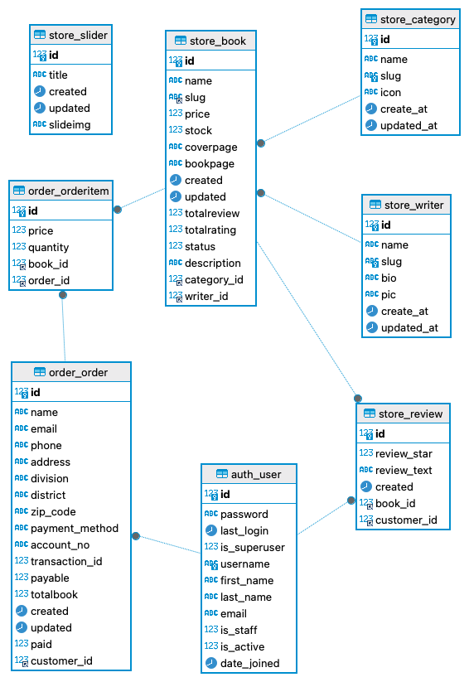
Database

Slide 7
Entity-Relationships
Admin Entity:
Attributes: id, password, last_login, is_superuser, username, first_name, last_name, email, is_staff, is_active, date_joined.
Category Entity:
Attributes: id, name, slug, icon, create_at, updated_at.
Writer Entity:
Attributes: id, name, slug, bio, pic, create_at, updated_at.
Book Entity:
Attributes: id, name, slug, price, stock, coverpage, bookpage, created, updated, totalreview, totalrating, status, description, category_id, writer_id.
Order Entity:
Attributes: id, customer_id, name, email, phone, address, division, district, zip_code, payment_method, account_no, transaction_id, payable, totalbook, created, updated, paid.

Slide 8
Entity-Relationships
Admin-Order Relationship:
An admin can be associated with multiple orders, but each order is managed by one admin. This relationship is illustrated by the admin_id foreign key in the Order table.
Cardinality: One-to-Many (1:N), as one admin can manage multiple orders.
Modality: Mandatory, as each order must be associated with an admin.
Category-Book Relationship:
A category can have multiple books, but each book belongs to one category. This relationship is depicted by the category_id foreign key in the Book table.
Cardinality: One-to-Many (1:N), as one category can have multiple books.
Modality: Mandatory, as each book must belong to a category.
Writer-Book Relationship:
A writer can have multiple books, but each book is written by one writer. This relationship is represented by the writer_id foreign key in the Book table.
Cardinality: One-to-Many (1:N), as one writer can write multiple books.
Modality: Mandatory, as each book must have a writer
Customer-Order Relationship:
A customer can place multiple orders, but each order is associated with one customer. This relationship is indicated by the customer_id foreign key in the Order table.
Cardinality: One-to-Many (1:N), as one customer can place multiple orders.
Modality: Mandatory, as each order must be associated with a customer.

Slide 9
Deployment
Step 1: Set Up EC2 Instance and RDS
1.1. Create EC2 Instance:
Launch an EC2 instance with the desired specifications.
Configure security groups to allow necessary inbound traffic, especially for SSH (port 22) and HTTP/HTTPS (ports 80 and 443).
1.2. Create RDS Instance:
Set up an RDS instance with the required database engine (e.g., PostgreSQL, MySQL).
Configure security groups to allow database connections from the EC2 instance.
Step 2: CodeCommit Repository and Code Deployment
2.1. Create CodeCommit Repository:
Set up a CodeCommit repository to host your Django application code.
Push your Django project code to the CodeCommit repository.
2.2. Clone Code to EC2 Instance:
SSH into the EC2 instance.
Clone the Django project repository using git clone.
2.3. Install Dependencies:
Install necessary dependencies and packages on the EC2 instance using pip.
2.4. Configure Django Settings:
Update Django settings to use the RDS database.
Configure static files and media settings.
2.5. Run Django Application:
Start the Django development server or use a production-ready server like Gunicorn.

Slide 10
Deployment
Step 3: Domain Registration and SSL Certificate
3.1. Register a Domain in Route 53:
In AWS Route 53, register a new domain or transfer an existing one.
3.2. Request ACM Certificate:
In ACM, request an SSL/TLS certificate for your domain.
Follow the validation steps to prove domain ownership.
Step 4: Configure API Gateway
4.1. Create API Gateway:
Set up a new API in API Gateway.
Create a new resource and method, such as HTTP proxy integration for Lambda.
4.2. Custom Domain Name:
Configure a custom domain name in API Gateway.
Select the ACM certificate for SSL termination.
4.3. Create Base Path Mapping:
Add a base path mapping for the custom domain to the API.

Slide 11
Deployment
Step 5: Configure DNS in Route 53
5.1. Create Record Set:
In Route 53, create a new record set for your domain.
Set the record type to "Alias" and choose the API Gateway custom domain as the target.
Step 6: Update Security Groups and Network ACLs
6.1. Security Groups:
Ensure that security groups associated with EC2 and RDS allow traffic from API Gateway and other necessary sources.
6.2. Network ACLs:
If using network ACLs, update them to allow traffic from API Gateway and other necessary sources.

Slide 12
Conclusion
The Online Bookstore Management System, developed using Django and deployed on AWS, presents a modern and efficient solution for book enthusiasts, demonstrating the evolution of software development practices.
Key features, including a robust admin dashboard, secure login system, and seamless frontend experience, contribute to an enhanced user interface and overall system functionality.
The database structure, with entities such as Admin, Category, Writer, Book, and Order, ensures organized data management and efficient relational database operations.
The deployment process on AWS, involving EC2, RDS, CodeCommit, Route 53, ACM, and API Gateway, showcases a comprehensive and scalable infrastructure for reliable system accessibility.
The successful implementation not only provides users with a convenient platform for book exploration and purchase but also highlights the adaptability of modern technologies to address evolving software development needs.
Overall, the Online Bookstore Management System stands as a testament to the effectiveness of contemporary software design and deployment strategies, offering a user-friendly and secure online bookstore experience.

